Slide 1
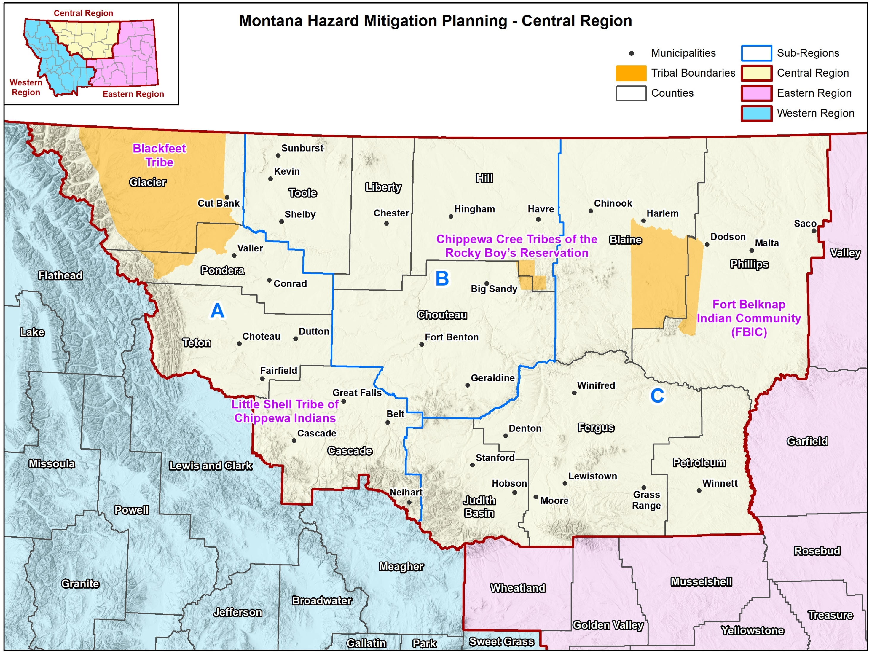
State of Montana Central Region Hazard Mitigation Plan
Hazard Mitigation Planning Team –
Meeting #3 – Mitigation Strategy
October 11-13, 2022 – 10:00 AM – 3:00 PM

Slide 2
Agenda
Introductions
Planning process update
Review of possible mitigation activities and alternatives
Discuss criteria for mitigation action selection and prioritization
Funding mitigation options
Review of progress on existing mitigation actions (working lunch- provided)
Brainstorming Session: Development of new mitigation actions (group process)
Prioritize mitigation actions (group process)
Preview of draft HIRA
Discuss plan implementation and maintenance
Next steps

Slide 3
Introductions

Slide 4
Introductions
Montana Disaster and Emergency Services
Sara Hartley – State Hazard Mitigation Officer
Hannah Shultz – Mitigation Coordinator
J. Lee Okeson – Central Region Supervisor
Joey Zahara – Central Region Field Officer
Ed Greiberis – Central Region Field Officer
County/Tribal Emergency Management Coordinators
Federal & State Partners
Other Stakeholders
Wood Project Team
Jeff Brislawn – Project Manger
Scott Field – Lead Planner, Central Region
Bob Vince – Project Principal, Local Support
Juliana Prosperi – Lead Planner, East Region
Amy Carr – Lead Planner, West Region
Mack Chambers – Lead GIS Analyst
Cameron Nelson – Hazard Mitigation Specialist
Chris Johnson – Hazard Mitigation Planner/GIS
Natalie Schoen – Hazard Mitigation Planner
Emily Geery – SWCA Wildfire Risk Assessment Support
Victoria Amato – SWCA Wildfire Planning Specialist

Slide 5
Planning Process Update

Slide 6
FEMA’s Nine-Step Planning Process
Step 1 Determine the Planning Area and Resources
Step 2 Build the Planning Team
Step 3 Create an Outreach Strategy
Step 4 Review Community Capabilities
Step 5 Conduct a Risk Assessment
Step 6 Develop a Mitigation Strategy
Step 7 Keep the Plan Current
Step 8 Review and Adopt the Plan
Step 9 Create a Safe and Resilient Community

Slide 7
Progress So Far
Kickoff meeting held March 31, 2022
Online public survey closed August 8th, 2022
265 total responses received
Risk Assessment Meeting held August 17th, 2022
GIS analysis & mapping completed
Draft HIRA being completed

Slide 8
Review of Possible Mitigation Activities and Alternatives

Slide 9
Hazard Mitigation Examples
Reduce the future demand for, and rising costs of, disaster response and recovery.
Retrofit a critical facility, enforce building codes, land use planning, remove a structure from a hazard area.

Slide 10
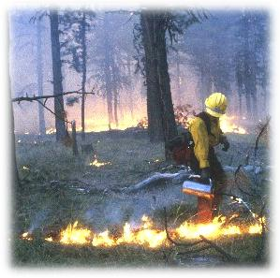
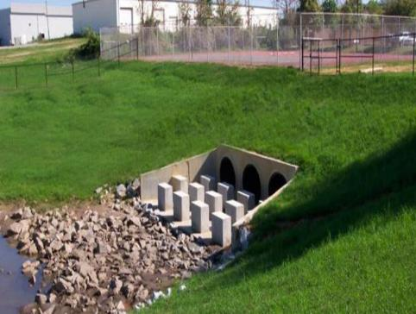
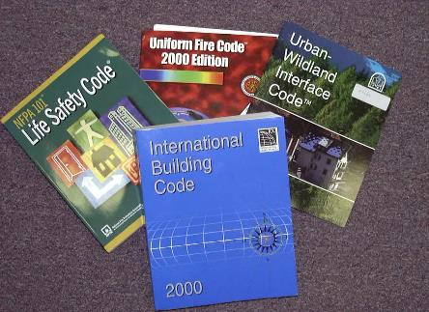
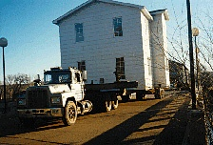
Review Mitigation Alternatives
► Alter
► Avert
► Adapt
► Avoid

Slide 11
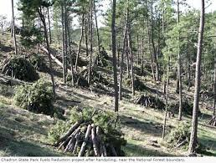
Review Mitigation Alternatives
► Alter the Hazard
Prescribed burns or fuels management to reduce wildfire intensity and severity
Draining lakes behind weakened dams

Slide 12
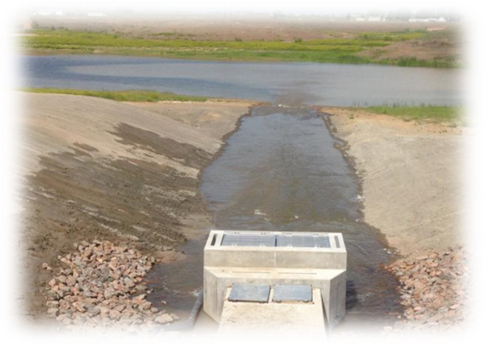
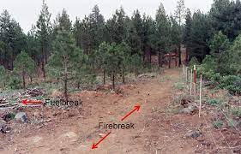
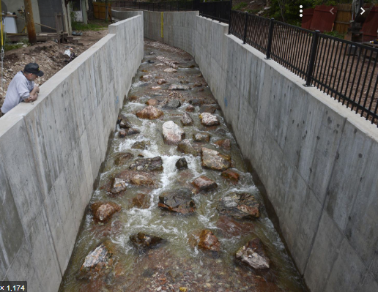
Review Mitigation Alternatives
► Avert the Hazard
Floodwalls and gates
Debris Nets and Basins
Drainage improvements
Channels and culverts
Firebreaks

Slide 13
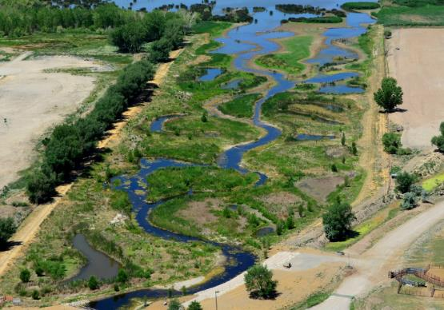
Review Mitigation Alternatives
► Avoid the Hazard
Acquisition
Relocation
Open space
Land use designation
Natural system protection

Slide 14
Review Mitigation Alternatives
► Adapt to the Hazard
Building codes
Construction standards
Land use and development regulations
Design standards
Monitoring and warning systems
Safe rooms and shelters

Slide 15
Mitigation Action Categories
Prevention
Structural projects
Public information
Property protection
Natural resource protection
Emergency services

Slide 16
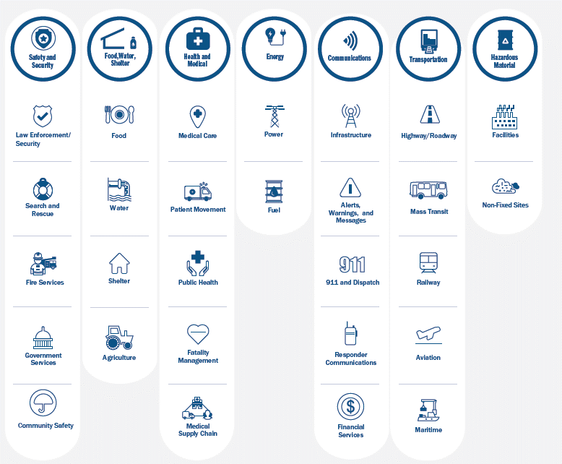
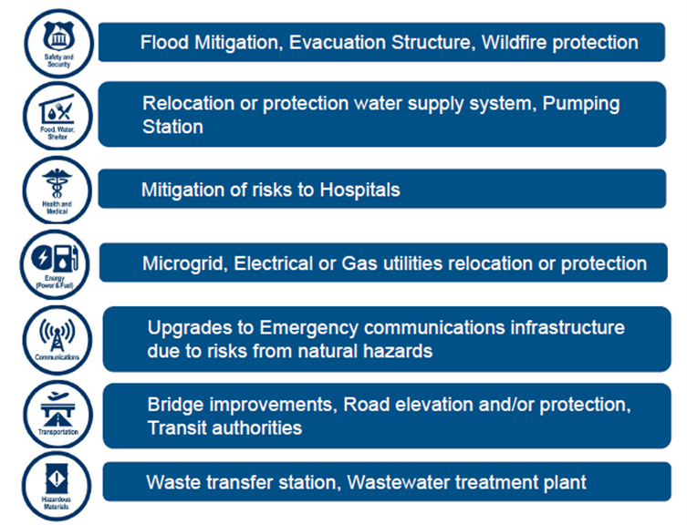
FEMA Community Lifelines

Slide 17
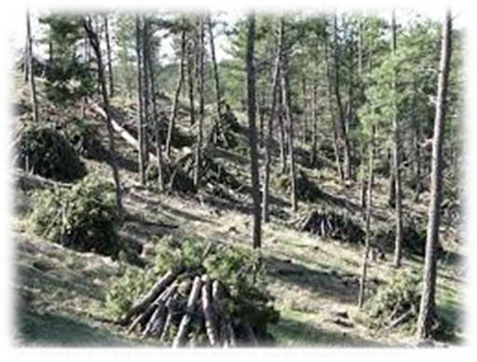
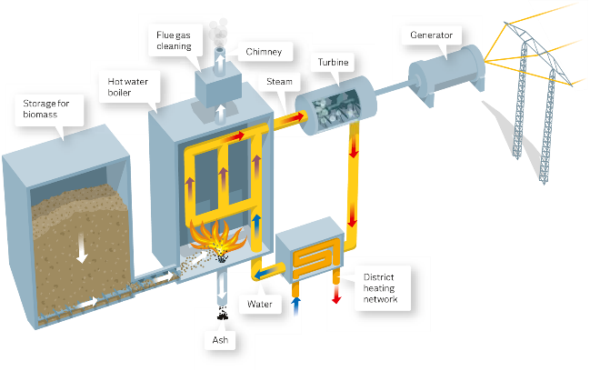
Projects Eligible for FEMA Funding - Wildfire
Defensible space
Structural protection through ignition-resistant construction activities
Hazardous fuels reduction activities
Community level vegetation management
Vegetation removal
Vegetation clearing and/or thinning
Slash removal
Vertical clearance of tree branches
Biomass Plant

Slide 18
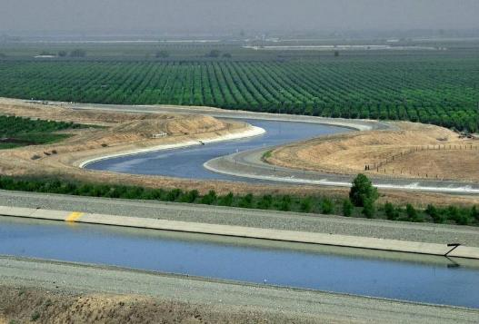
Projects Eligible for FEMA Funding - Flood Mitigation
Acquisition
Dry and wet flood-proofing
Elevation
Minor localized flood reduction projects
Detention ponds
Channel stabilization
New policy change: levee projects if no duplication of programs with Army Corps
Infrastructure retrofit
Culverts, bridges, etc.

Slide 19
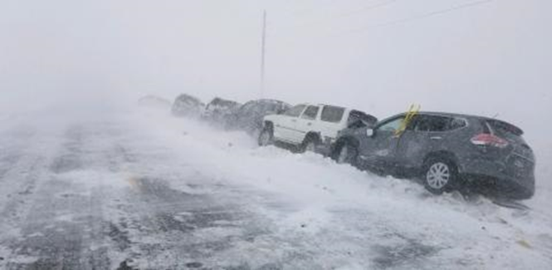
Projects Eligible for FEMA Funding – Winter Storm
Ensure development and enforcement of building codes for snow loads
Burying/hardening overhead power lines
Informing the public about severe winter weather impacts
Organizing outreach to vulnerable populations including establishing and promoting accessible heating centers
Retrofitting public buildings to withstand snow loads and prevent roof collapse

Slide 20
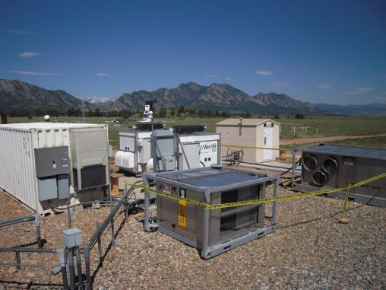
Projects Eligible for FEMA Funding (Other Hazards)
Landslides/geologic hazards
Channel or slope stabilization - protection of critical facilities
Property acquisition
Utility protection/ infrastructure retrofit
Safe rooms
Generators
Microgrids/smart grids
Seismic building/infrastructure retrofit
Climate resilient mitigation activities
Groundwater recharge
Green infrastructure

Slide 21
Things FEMA Will Not Count Towards The Requirement
“Conduct routine maintenance…”
“Develop a program…”
“Conduct a study…”
“Improvements were recently completed on…”
“Identify projects to reduce risk…”

Slide 22
Discuss Criteria for Mitigation Action Selection and Prioritization

Slide 23
Mitigation Action Selection and Prioritization
STAPLEE
Social
Technical
Administrative
Political
Legal
Economic
Environmental
Other Things to Consider
Life Safety
Vulnerable Populations
Addressing High Risk Hazards
Protect Critical Facilities/Assets
Multiple Goals/Hazards

Slide 24
Funding Mitigation Options

Slide 25
Funding Sources
Federal & state grants
Local/tribal budgets
Capital improvement budget
Healthcare Coalition
Public-private partnerships
Conservation coalitions
Fees/assessments/levies
Other?

Slide 26
FEMA Hazard Mitigation Grants
Projects must be tied directly to the mitigation goals, objectives, and specific actions in your HMP.
Most have 25% local match
HMGP: Hazard Mitigation Grant Program, post-disaster, all natural hazards
HMGP Post-Fire: available following an FMAG declaration
PA 406: Public Assistance Program Section 406, post-disaster, add mitigation measures to PA projects to avoid/reduce future damage
BRIC: Building Resilient Infrastructure & Communities, pre-disaster/annual cycle, all natural hazards, infrastructure emphasis
FMA: Flood Mitigation Assistance, pre-disaster/annual cycle, flood hazard, NFIP insured structures & communities
HHPD: High Hazard Potential Dam Program, pre-disaster/annual cycle, for non-Federal high hazard dams rated Unsatisfactory. (local match varies)

Slide 27
FEMA Preparedness Grants
Emergency Management Performance Grant
Homeland Security Grant Program
Tribal Homeland Security Grant
Nonprofit Security Grant
Transit Security Grant/Intercity Bus Security Grant
Port Security Grant
Assistance to Firefighters Grants
Regional Catastrophic Grant Program
National Earthquake Hazards Reduction Program Grant
Community Assistance Program

Slide 28
Other Grants
US DOT
BIA
HUD
EPA
USDA
USFW
CDC
BOR
USACE
NOAA/NWS
SBA
State of Montana grants?

Slide 29
Review of Progress on Existing Mitigation Actions

Slide 30
Mitigation Actions from Previous Plans
# | Jurisdiction | Action/Project Name & Description | Hazards Mitigated | Lead Agency | Partner Agencies | Cost Estimate | Potential Funding Sources | Schedule/ Timeline | Old Priority
1.1 | Chester | Address repeated road and property flash flooding by enhancing storm-water drainage system | Flood | City of Chester |  | High | City of Chester, MT DES, FEMA |  | High
1.2 | Chester | Replace the one existing siren for the city, enhance coverage for whole city. | All | City of Chester, | County DES | Meduim | City of Chester, County |  | Medium
1.3 | Chester | Continue participation in NFIP. Find assistance to administer regulations so that development complies | Flood | City of Chester, | County DES | Medium | City of Chester, MT DES, Co DES |  | Medium
2.1 | Liberty County | Identify methods, adopt, and educate people on how to receive warning/alert information. | All | County Commissioners, | City of Chester, LEPC, County DES | Low | Existing budgets |  | High
2.2 | Liberty County | Manage forest fuels on Mt. Royal communications site | Wildland Fire | County Fire Warden, | County Commissioners | Medium | DNRC, County, MT DES |  | High
2.3 | Liberty County | Update the hazardous materials flow study | Hazmat | LEPC, | County DES | Medium | FEMA, MT DES, County DES |  | High
2.4 | Liberty County | Offer a CPR and First Aid course | All | Hospital, | LEPC | High | Hospital Attendees |  | High
2.5 | Liberty County | Complete rural addressing system and install fireproof road signs | All | County Planning and Road Dept |  | High | County |  | Medium
2.6 | Liberty County | Continue to enhance radio availability. | All | County |  | Medium | County DES and Fire, MT DES, DNRC |  | Medium
2.7 | Liberty County | Purchase radios for Joplin | All | County Commissioners, | DES | Medium | County, DNRC |  | Medium
2.8 | Liberty County | Educate school children on what to during a natural disaster | All | County DES, | LEPC | Low | Existing budgets |  | Medium

Slide 31
Prior Mitigation Actions
Not Started: Work has not begun
In Progress: Work has begun but is not completed
Completed: The action has been finished
Annual Implementation: Ongoing with no specific end date
Deleted: The action is no longer relevant or cancelled due to changing priorities, lack of funds, etc.
There is no requirement or expectation to have completed any/all previous actions.

Slide 32
Activity: Mitigation Status Updates
Break into groups by County/Tribe.
Spreadsheets showing the actions from your previous plans will be distributed.
Review and update the status of those actions you can.
We don’t expect 100% today
…but we will need 100% before we can submit to FEMA.
Make notes of who you may need to follow up with after the meeting.
Electronic copies will be emailed out next week.

Slide 33
Mitigation Actions Status Update
2022 Status
Not Started
In Progress
Completed
Annual Implementation
Deleted
2022 Priority
High
Medium
Low
2022 Implementation Notes
When was it completed?
Why are you deleting it?
What has been accomplished so far?
What roadblocks have prevented implementation?
Update other columns where possible
Schedule/Timeline
Budget
Partner Agencies
Etc.

Slide 34
Development of New Mitigation Actions

Slide 35
Disaster Mitigation Act Requirements
► Must have at least one new action
► Must have at least one action for each applicable hazard
► Must be “true” mitigation to meet FEMA requirements
► Preparedness & response actions may also be included
► Must address one or more mitigation goals/objectives
► Actions must be prioritized
► Actions must have detail on implementation & administration
► Actions must have a basic review of benefit vs cost
► Must include actions that address existing and future development

Slide 36
New Mitigation Actions Are Not “Binding”
The mitigation strategy is a “wish list”
not a commitment of resources.

Slide 37
DRAFT Central Region Mitigation Goals
Reduce impacts to people, property, the environment, and the economy from hazards.
Protect community lifelines and critical infrastructure to ensure the continuity of essential services.
Increase public awareness and participation in hazard mitigation.
Sustain and enhance jurisdictional capabilities to enact mitigation activities.
Integrate hazard mitigation into other plans, processes, and regulations.
Promote regional cooperation and leverage partnerships in mitigation solutions where possible.

Slide 38
Mitigation Strategy Elements
Goals
General guidelines that explain what you want to achieve
Usually broad policy/vision statements
Objectives (optional)
Define strategies or implementation steps to attain goals
Specific and measurable
Actions
Specific projects/activities to achieve goals & objectives

Slide 39
Central Region Hazards – DRAFT Significance Rankings
Hazard | Geographic Area | Magnitude/ Severity | Probability | Significance
Communicable Disease | Extensive | Critical | Occasional | Medium
Cyber-Attack | Significant | Critical | Likely | Medium
Dam Failure | Significant | Critical | Occasional | Medium
Drought | Extensive | Critical | Likely | Medium
Earthquake | Significant | Limited | Likely | Low
Flooding | Limited | Critical | Likely | Medium
Hazardous Material | Limited | Negligible | Likely | Low
Landslide | Limited | Negligible | Likely | Low
Severe Summer Weather | Extensive | Limited | Highly Likely | Medium
Severe Winter Weather | Extensive | Critical | Highly Likely | High
Human Conflict | Significant | Limited | Occasional | Low
Tornadoes/Windstorms | Extensive | Limited | Highly Likely | Medium
Transportation Accidents | Limited | Limited | Highly Likely | Low
Volcanic Ash | Extensive | Limited | Unlikely | Low
Wildland/Rangeland Fire | Extensive | Critical | Highly Likely | High

Slide 40
FEMA Community Lifelines

Slide 41
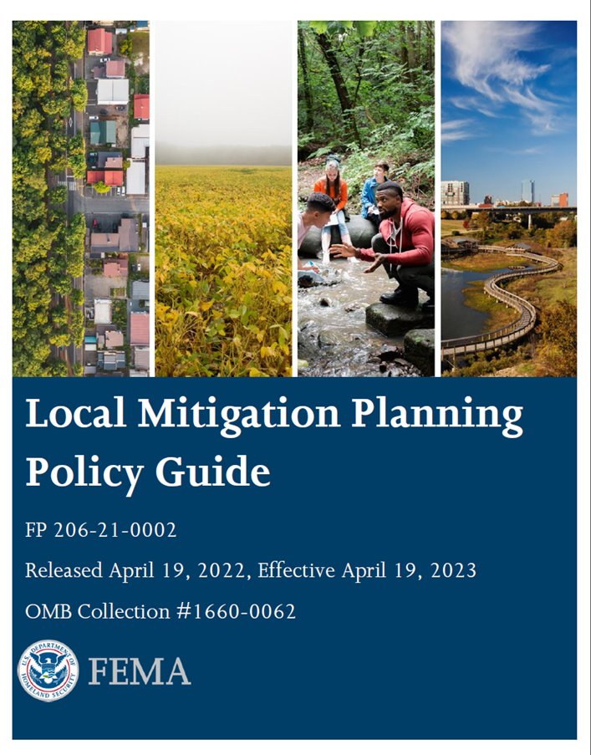
Sources of Ideas for Mitigation Actions
► Draft Hazard Identification & Risk Assessment
► Handout on action alternatives by hazard & category
► Public survey input
► Water protection & usage plans, watershed plans, drainage plans, etc.
► Capital Improvement Plan
► Community Wildfire Protection Plan
► FEMA ‘Mitigation Action Portfolio’ publication
https://www.fema.gov/sites/default/files/2020-08/fema_mitigation-action-portfolio-support-document_08-01-2020_0.pdf

Slide 42
Public Survey Results
Please indicate the types of mitigation actions that you think should have the highest priority.

Slide 43
Suggested Ideas for New Mitigation Actions
Provide indoor NOAA weather radios to critical facilities, community shelters, city facilities, schools and other identified areas.
Install additional snow fences at strategic locations to minimize roadway impacts and transportation incidents
Create a water conservation public awareness and educational campaign, including educational materials on water conservation measures to implement during drought periods.
Implement the high priority projects identified in CWPPs
Notification system for tourists for thunderstorms, fire, floods, and dam failure as visitors may not get emergency notifications on their phones.
Strategic grassland fuels reduction efforts surrounding vulnerable communities
Ensure critical communication infrastructure is grounded to mitigate lightning strikes.

Slide 44
Activity: Develop New Mitigation Actions
What new mitigation actions should be added to the Plan?
Write one idea for each new action on a blank worksheet
You are encouraged to collaborate with other agencies or jurisdictions
Include details where you can, but it’s okay if you don’t know or can elaborate later.
Include the Jurisdiction and Lead Agency
Feel free to submit more than one
Review each other’s suggestions

Slide 45
Prioritization of Mitigation Actions

Slide 46
Mitigation Action Selection and Prioritization
STAPLEE
Social
Technical
Administrative
Political
Legal
Economic
Environmental
Other Factors to Consider
Life safety
Addressing high risk hazards
Protect critical facilities
Multiple goals/hazards
Vulnerable populations and equity

Slide 47
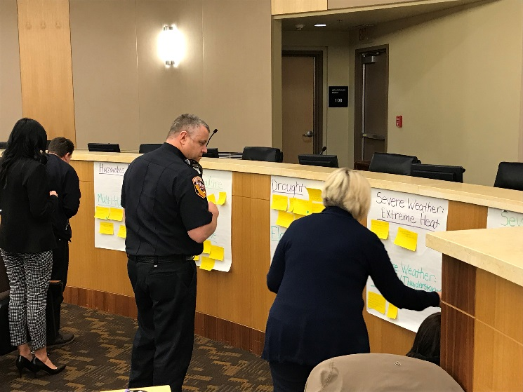
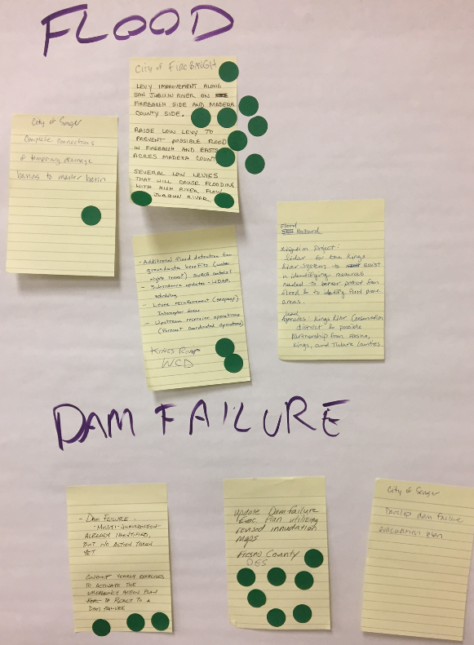
Activity: New Mitigation Action Prioritization
Connect the Dots!
4 Dots per Person
Indicate which should be priority mitigation actions with a dot, keeping STAPLEE Criteria in mind
Dots will later be converted into a High, Medium, Low initial prioritization
Notes:
What we will talk about today.

Slide 48
Preview of Draft HIRA

Slide 49
DRAFT Hazard Identification & Risk Assessment
Coming soon for planning team review
It is critical we get your feedback and input – it’s YOUR plan!
Review both for the region as a whole and for your jurisdiction specifically
Feedback will be incorporated into full draft and resent for review

Slide 50
Regional HMP Table of Contents
Introduction
Community Profile
Planning Process
Hazard Identification & Risk Assessment
Mitigation Strategy
Plan Implementation & Maintenance
Jurisdictional Annexes
Appendices

Slide 51
HIRA Contents
Hazard Identification
Disaster Declaration History
Hazards Considered
Methodology
Climate Change
Hazard Rankings/Summary
Assets At Risk
Population
General Property
Critical Facilities & Lifelines
Cultural, Historical and Natural Resources
Hazard Profiles

Slide 52
Hazard Profiles
Hazard Description
Geographical Area Affected
Past Events
Magnitude/Severity
Frequency/Likelihood of Occurrence
Vulnerability Assessment
Risk Summary

Slide 53
Hazard Vulnerability Assessments
People
Property
Critical Facilities & Lifelines
Economy
Historic & Cultural Resources
Natural Resources
Development Trends

Slide 54
Plan Implementation and Maintenance

Slide 55
Plan Implementation & Maintenance
The plan must describe how, when, and by whom the plan will be:
Monitored:
Tracking implementation of mitigation actions
Identifying new actions as needed
Losses avoided due to mitigation activities
Evaluated
Effectiveness at achieving goals and objectives
What hindered implementation?
What factors contributed to success?
Updated
Reviewed & revised at least once every five years.
Continued Public Involvement
Engaged and given opportunity to provide input

Slide 56
Plan Implementation & Maintenance
The following tasks should be conducted “regularly”, at least annually
HIRA review – changes to hazards or vulnerabilities
Review of recent hazard incidents
Updates on mitigation actions
Assess effectiveness of completed mitigation actions
Annual face to face meeting of Hazard Mitigation Planning Team to discuss updates on mitigation actions and/or significant impactors/events
Target is first quarter of each year?
Job aids:
Sample agenda for annual meeting in appendix

Slide 57
Incorporation into Other Planning Mechanisms
Mitigation is most successful when it is incorporated into the day-to-day functions and priorities of government and development.
Implementation through existing plans and/or programs is recommended wherever possible:
Comprehensive Plan
Zoning/Subdivision Ordinances
Floodplain Ordinance
Capital Improvements Plan
Emergency Operations Plan
Discussion: Provide at least one opportunity to incorporate or cross reference the HMP into other planning mechanisms
FEMA Requirement – Element C6
a. Does the plan identify the local planning mechanisms where hazard mitigation information and/or actions may be incorporated?
b. Does the plan describe each community’s process to integrate the data, information, and hazard mitigation goals and actions into other planning mechanisms?
c. The updated plan must explain how the jurisdiction(s) incorporated the mitigation plan, when appropriate, into other planning mechanisms as a demonstration of progress in local hazard mitigation efforts.

Slide 58
Next Steps

Slide 59
Project Schedule
Project Milestones | Anticipated Timeline
Meeting #2 HIRA review | August
Meeting #3 Mitigation Strategy | October
HIRA Draft for HMPC review | October
Full Draft for HMPC review | November
Public Review Draft | December
DHSEM Review Draft | January – February 2023
Final Plan for FEMA Review (estimated) | March – April 2023
Final Approved HMP for local adoption | May-July 2023

Slide 60
Next Steps
Please return Plan Update Guide if you haven’t already
Provide input on mitigation action statuses
Submit additional new mitigation actions
Review and comment on HIRA and full draft plan when available
Think about what local-level Objectives you may want to adopt to supplement the plan’s Goals
Stay informed by email of upcoming meetings

Slide 61
Questions? Thank you!
Project Manager
Jeff Brislawn
Wood Environment & Infrastructure Solutions, Inc
Jeff.brislawn@woodplc.com
303-704-5506
Central Region Project Manager/
Mitigation Coordinator
Hannah Shultz
Montana DES
Hannah.Shultz@mt.gov
406-292-1092
Lead Planner
Scott Field
Wood Environment & Infrastructure Solutions, Inc
Scott.field@woodplc.com
720-569-9266
wsp.com

